Slide 1
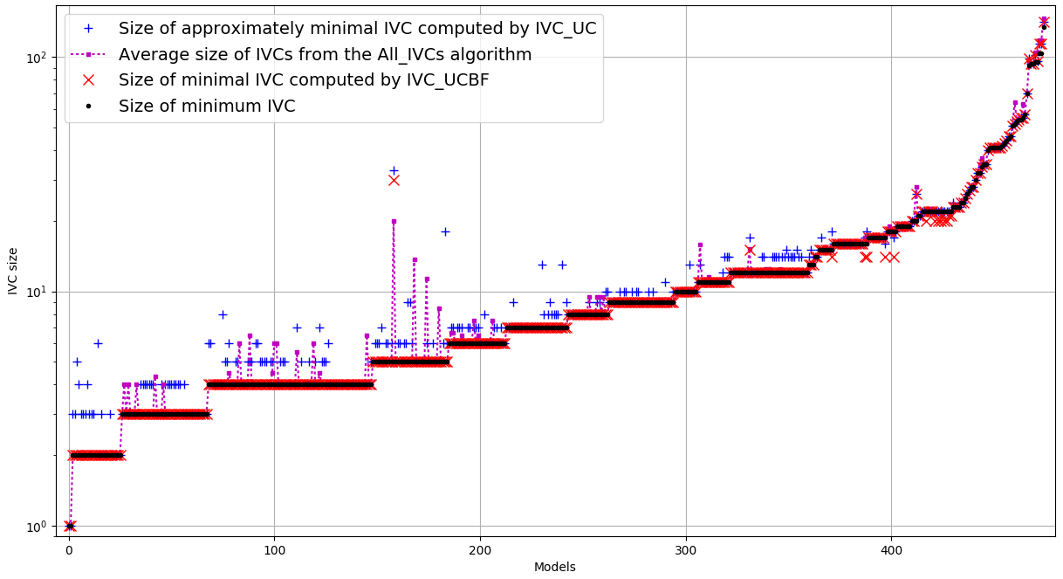
This is the same as previous slide sorted differently as you see in some cases size of UCBF is smaller than the Minimum set found by All_IVCs. I checked those, it’s because of timeouts
OLD EXPR

Slide 2
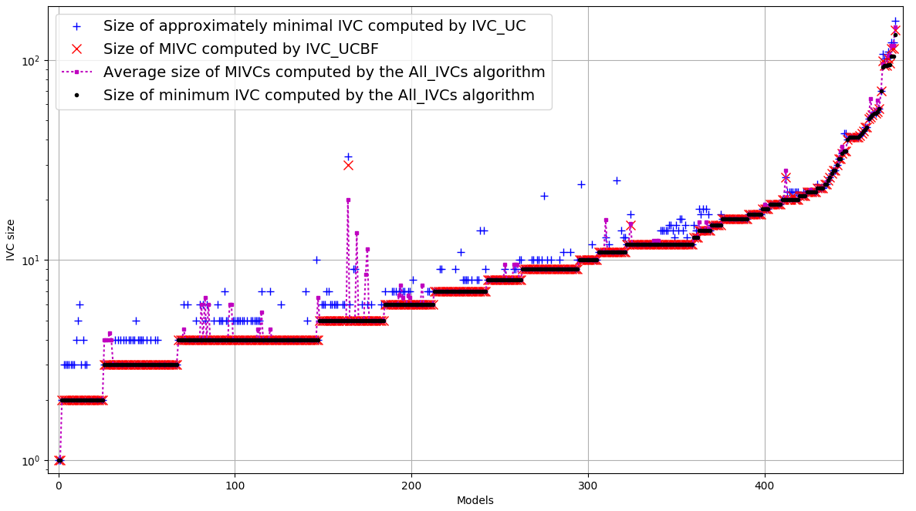
NEW EXPR

Slide 3
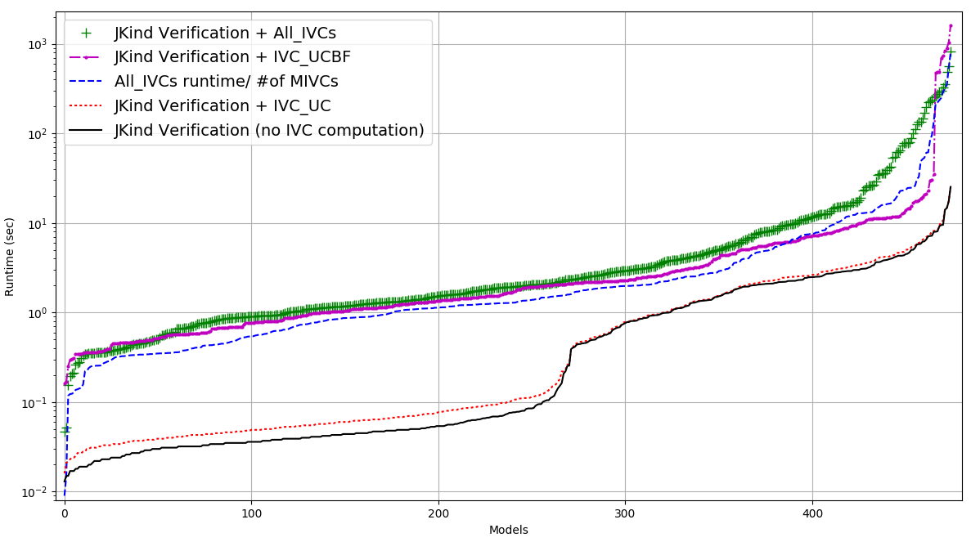

Slide 4
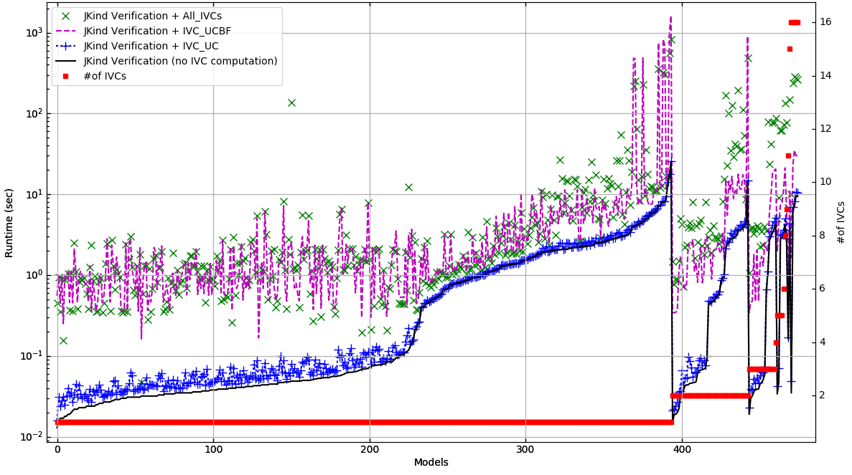

Slide 5
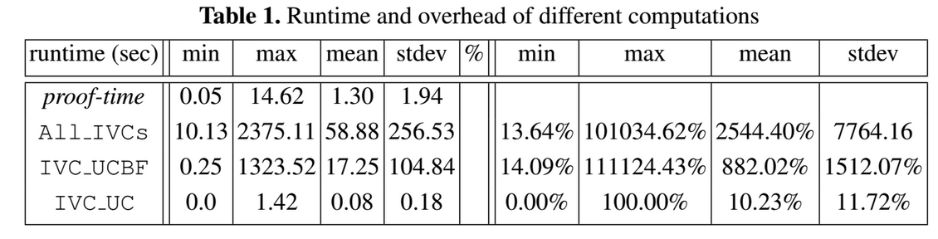
OLD EXPR
Runtime | Min | Max | Mean | Stdev | % | Min | Max | Mean | stdev
Proof-time | 0.013 | 25.289 | 1.172 | 2.2927
All_IVCs | 0.009 | 792.014 | 16.4572 | 64.491 |  | 12.337% | 277269.387% | 3129.320% | 13023.554%
IVC_UCBF | 0.163 | 1625.289 | 18.624 | 119.59 |  | 18.710% | 15359.574% | 1963.605% | 2497.912%
IVC_UC | 0.003 | 1.126 | 0.0784 | 0.158 |  | 0.116% | 122.727% | 24.1387% | 25.3127%
NEW EXPR

Slide 6
ratio of all-ivcs runtime (includes proof) to UCBF
min: 28.834355828220858%
max: 5251.584234930448%
stdev: 344.69395839%
average: 188.042850256%
NEW EXPR
min: 42.992%
max: 6584.481%
stdev: 838.615%
average: 342.323%
OLD EXPR

Slide 7
Increase size of ivcs UCBF to UC
min : 100.0%
max : 300.0%
stdev: 23.6403502907%
average : 112.1829568%
Same as before

Slide 8
Size of IVCs ---- OLD EXPR
min size of minimum IVCs: 1
max size of minimum IVCs: 134
stdev size of minimum IVCs: 15.5498599009
average size of minimum IVCs: 12.0778947368
min size of minimal IVCs from IVC_UCBF: 1
max size of minimal IVCs from IVC_UCBF: 141
stdev size of minimal IVCs from IVC_UCBF: 16.107382867
average size of minimal IVCs from IVC_UCBF: 12.1852631579
min size of IVCs from IVC_UC: 1
max size of IVCs from IVC_UC: 141
stdev size of IVCs from IVC_UC: 16.000801365
average size of IVCs from IVC_UC: 12.7536842105
min size of IVCs from All_IVCs: 1
max size of IVCs from All_IVCs: 159
stdev size of IVCs from All_IVCs: 1.16837074951
average size of IVCs from All_IVCs: 12.4623907496

Slide 9
Size of IVCs ---- NEW EXPR
min size of minimum IVCs: 1
max size of minimum IVCs: 134
stdev size of minimum IVCs: 15.5126625134
average size of minimum IVCs: 12.012605042
min size of minimal IVCs from IVC_UCBF: 1
max size of minimal IVCs from IVC_UCBF: 141
stdev size of minimal IVCs from IVC_UCBF: 16.0963720039
average size of minimal IVCs from IVC_UCBF: 12.1869747899
min size of IVCs from IVC_UC: 1
max size of IVCs from IVC_UC: 157
stdev size of IVCs from IVC_UC: 16.9943632472
average size of IVCs from IVC_UC: 13.0504201681
min size of IVCs from All_IVCs: 1
max size of IVCs from All_IVCs: 159
stdev size of IVCs from All_IVCs: 1.16932579383
average size of IVCs from All_IVCs: 12.4015453909

